Slide 1
CS626 - Speech, Natural Language Processing, and the Web
Assignment-1a
POS Tagging Using HMM
Group 41
Aryan Bhosale 210040024 Mechanical
Atishay Jain 210050026 CSE
Faizan Ansari 210100058 Mechanical
Areeb Asgar 210100022 Mechanical
Date: 07/09/2024

Slide 2
Problem Statement
Objective: Given a sequence of words, produce the POS tag sequence using HMM-Viterbi
Input: The quick brown fox jumps over the lazy dog
Output:The_{DET} quick_{ADJ} brown_{ADJ} fox_{NOUN} jumps_{VERB} over_{ADP} the_{DET} lazy_{ADJ}dog_{NOUN}
Dataset: Brown corpus
Use Universal Tag Set (12 in number)
NOUN: nouns ; VERB: verbs ; ADJ: adjectives ;
ADV: adverbs ; PRON: pronouns ; DET: determiners and articles
ADP: prepositions and postpositions ; NUM: numerals
CONJ: conjunctions ; PRT: particles
‘.’ : punctuation marks ; X: other categories like abbreviations or foreign words
k-fold cross validation (k=5)

Slide 3
Data Processing Info (Pre-processing)
The dataset ‘brown’ and the universal tagset was downloaded from the nltk corpus
A list of dataset with the universal tagset was created using brown.tagged_sents(tagset='universal') (inbuilt command).
All words in dataset were set to lowercase for uniformity.
Missing words and their probabilities were handle in the viterbi only where a probability of 1e-7 was assigned to the points that were missing.

Slide 4
Overall performance
Precision : 0.94
Recall : 0.91
F-score (3 values)
F₁-score : 0.927
F_{0.5}-score : 0.935
F₂-score : 0.919

Slide 5
Per POS performance
.
P: 0.996, R: 0.999, F1: 0.997
ADJ
P: 0.920, R: 0.910, F1: 0.915
ADP
P: 0.949, R: 0,968, F1: 0.958
ADV
P: 0.908, R: 0.895, F1: 0.901
CONJ
P: 0.993, R: 0.994, F1: 0.993
DET
P: 0.962, R: 0.986, F1: 0.974
NOUN
P: 0.959, R: 0.955, F1: 0.957
NUM
P: 0.971, R: 0.914, F1: 0.942
PRON
P: 0.954, R: 0.985, F1: 0.969
PRT
P: 0.908, R: 0.907, F1: 0.907
VERB
P: 0.972, R: 0.950, F1: 0.961
X
P: 0.800 , R: 0.504, F1: 0.618

Slide 6
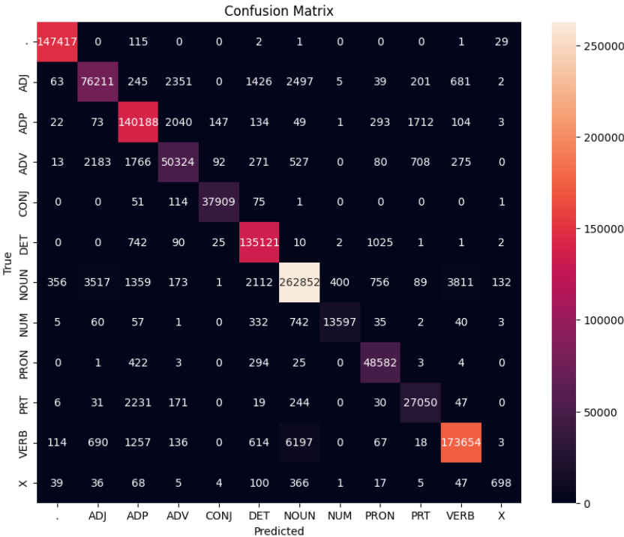
Confusion Matrix (12 X 12) (can give heat map)

Slide 7
Interpretation of confusion
(error analysis)
Most confused tag: X (P: 0.800 , R: 0.504, F1: 0.618)
Code-mixing: Mi diapiace, Signora, ma insomma. (Spanish sentences being used in an English Corpus)
Then she said, “Allons”, and we got up and went to my hotel without another word. “Allons” is an unknown word (French) but has been tagged as a noun (most common)
Adverbs being confused as adjectives
He felt a little sick at his stomach. “little” is an adverb (ADV) , incorrectly tagged as a ADJ.
This can be because:
"little" is modifying the adjective "sick," describing the degree or extent of sickness.
If "little" were an adjective, it would be modifying a noun, like "stomach." But here, "stomach" is a prepositional object and not directly modified by "little."
The phrase "a little sick" is an idiom meaning "somewhat sick" or "slightly ill"
Adverbs being confused as adjectives
But to Keith's London-bred mind, such acreage sounded rather invincible. “rather” is an adverb (ADV) , incorrectly tagged as a ADP.

Slide 8
Interpretation of confusion
(error analysis)
Verb confused as Noun
Ex: He ceased weeping. “weeping” is a verb, but it has been incorrectly tagged as a Noun. This can be because:
"weeping" is directly affected by the verb "ceased", and verbs are usually followed by nouns.
-ing form indicates an ongoing action, which is closer to a verb usage than a noun.
Ex: It's nothing to fool with. “fool” is a verb, but it has been incorrectly tagged as a Noun.
Noun confused as Verb
The shot reverberated in diminishing whiplashes of sound.
“whiplashes” is a Noun, but it has been incorrectly tagged as a verb.

Slide 9
Inferencing/Decoding Info
Tags, initial, transitional and emission probabilities are given as input to the algorithm.
The output is the most probable sequence of words.
A probability table was set up to tabulate different probabilities, it was initialised with the initial probabilities in the path.
Then a recursive loop is executed where on the basis of markov’s assumption only those paths are retained which gives the instant maximum in the next step.
For the last tag transitional probabilities are skipped and then tree is terminated and best path is returned.
Notes:
Statistical Nature of HMMs
Transition and Emission Probabilities: HMMs rely on probabilities derived from training data, such as the Brown corpus. If the training data contains instances where an adverb is frequently used in contexts similar to adjectives or prepositions, the model may incorrectly assign the wrong tag based on learned probabilities. For instance, if "quickly" appears in contexts where adjectives are common, it might be tagged as an adjective.
Limited Contextual Awareness: HMMs utilize a Markov assumption, which posits that the next state (POS tag) depends only on the current state. This limitation means that HMMs may not fully capture the broader context needed to accurately differentiate between similar grammatical forms, leading to potential tagging errors.

Slide 10
Benchmarking against ChatGPT
We used TreeBank dataset (10 sentences out of it)
Chat GPT's confusion
Distinguishing between Adjective and Noun (based on output of confusion matrix)
Comparison for POS tags from HMM Model
In some words like “white house”, ChatGPT took it a single entity and gave it a Noun tag (using its knowledge)
However in the dataset, true tags were Adjective and Noun
Then we had to force the prompt of ChatGPT to give same length tags for each sentence, and it gave Noun to both of them
Leading to ChatGPT’s confusion between Adj and Noun, and thus HMM performed better in this case

Slide 11
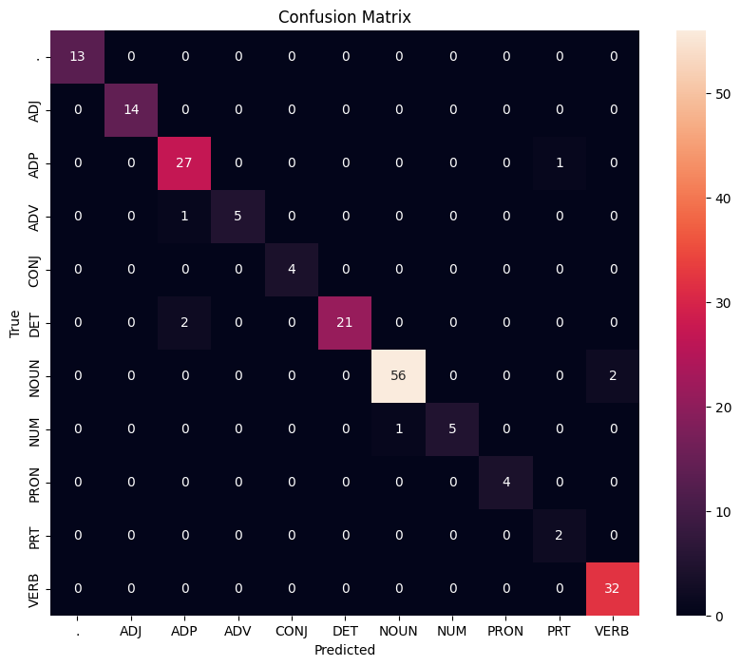
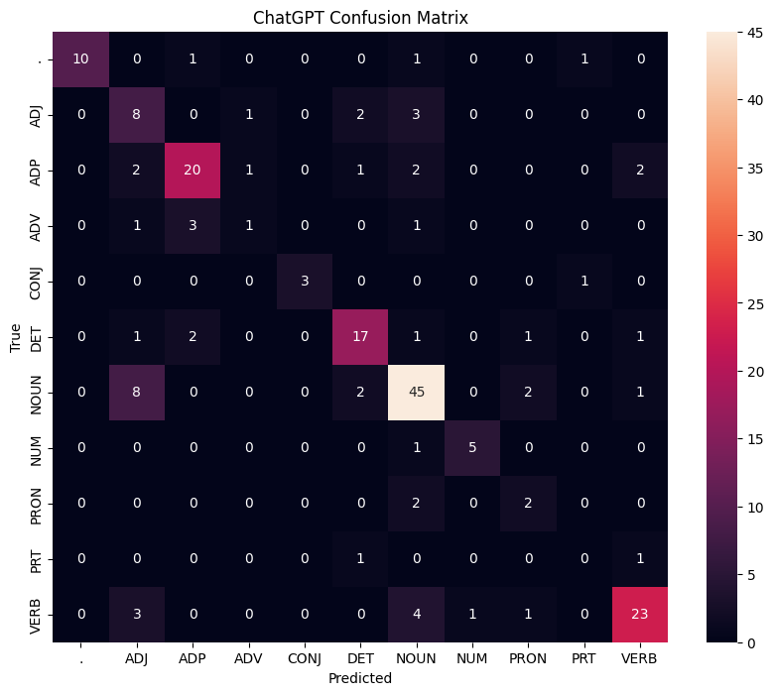
Benchmarking against ChatGPT
Accuracy: 0.963
Accuracy: 0.726

Slide 12
Challenges faced
Handling missing data and transitional probabilities.
Correctly implementing Viterbi for efficient computation.
Though numerical stability was an issue, things went quite smoothly for us.
Mastering theoretical concepts and debugging to ease out implementation issues.

Slide 13
Learning
Understanding HMMs:
Language modelling as a sequential task -
markov (POS tag depends only on the previous tag) & emission (tag depends on corresponding word only) assumption
POS tagging as a foundation for higher level NLP tasks:
Parsing, Named-entity recognition and information extraction: all require understanding of interactions between different parts of speech

Slide 14
References
For Brown corpus http://www.nltk.org/nltk_data
For GUI
https://www.gradio.app/
https://streamlit.io/
Any JS or python framework
Other references e.g. Lectures notes, videos, blogs etc

Slide 15
Marking Scheme (50)
Demo working- 10/10 (if not working - 0)
Implemented Viterbi and Clarity on Viterbi- 5/5
Transition and Lexical tables clearly described- 5/5
Confusion matrix drawn and error analysed- 5/5
Overall F₁-score
> 90 - 10/10
>80 & <=90 - 8/10
>70 & <=80 - 7/10
so on.
Unknown word handling- done (5/5; else 0)
Benchmarking against ChatGPT (10 else 0)
Note: Must have GUI, otherwise no mark will be given for demo.

